Slide 1
Rapids GroupBy
Aaron Nightingale
Christopher Patterson
Jersin Nguetio
Menglu Liang
Tonglin Chen

Slide 2
Design Overview

Slide 3
Data structure
Provided data set is in column major.
Matrix is flattened to 1D array for easy memory copying
Input: 1) Key matrix : A matrix with M rows and N columns; rows of this matrix are the “keys” of the reduce-by-key operation
2) Value matrix : A matrix with M rows and J columns
3) Operation array: An array of J reduction operations
Output: 1) Keys: U rows and N columns, where U is the number of unique keys from the input Keys matrix; Row “i” of the output Keys matrix corresponds to row “i” of the output Values matrix.
2) Values: U rows and J columns, where U is the number of unique keys from the input Keys matrix;Row “i” of the output Values matrix corresponds to row “i” of the output Keys matrix;

Slide 4
Data structure example
Sample key and value matrix
key\entries | 0 | 1 | 2 | 3 | 4 | 5
0 | 1 | 1 | 4 | 9 | 8 | 4
1 | 2 | 2 | 5 | 2 | 9 | 5
2 | 3 | 3 | 6 | 4 | 1 | 6
value
0 | 1 | 3 | 5 | 7 | 1 | 8
1 | 2 | 4 | 9 | 3 | 1 | 9

Slide 5
Expected output on (max, count)
Output Key and Value Matrix
key\entries | 0 | 1 | 2 | 3
0 | 1 | 4 | 9 | 8
1 | 2 | 5 | 2 | 9
2 | 3 | 6 | 4 | 1
value
0 | 3 | 5 | 7 | 8
1 | 2 | 1 | 1 | 2

Slide 6
Implementation

Slide 7

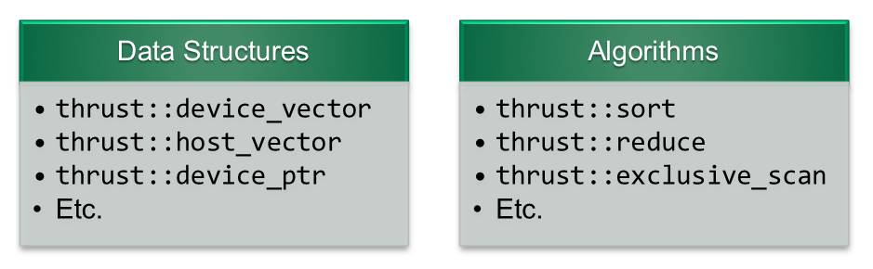
Thrust
Library providing parallel data structures and algorithms
Reduce, scan, copy, etc.
Customizable for different data representations
Reduce by key for sorted key input
Special reduction operations for add, min, max, etc.
Allows for quick implementation for our case of many value operations
Less control over more advanced CUDA features
Shared memory
Streams
etc.
Notes:
Thrust gives us STL like data structures for parallel algorithms
Provides many algorithms such as reductions, copy, scan
Much of these are customizable
Useful for our case with key matrix, multiple columns per key
Reductions can be done by keys if sorted
Reductions also allow for special operators like addition, min, max and division
Simple to use, respectable performance
We don’t have as good control over cuda features
Shared memory
Streams
But we can mix in our own kernels if needed

Slide 8
GroupBy
Input:
mxn matrix
Each row corresponding to a key
Unknown number of unique keys
Output:
pxn matrix
Each row corresponding to a unique key
Process:
Sort keys
Hash keys for easier compaction
Compact hashed keys to obtain just unique keys
Copy back original n columns for each unique key
Notes:
We start with an mxn matrix of m keys. n values representing one key
We don't know how many unique keys there are in our dataset
We want to make this matrix compact to represent p unique keys
Process:
Sort the original keys
Hash these as it can be done quickly and makes reductions and other operations easier
Compact the hashed array to be just our unique hash keys
Use an index array of the original rows in that compaction
Use compacted index array to copy back unique key rows

Slide 9
GroupBy
Original Keys
Sorted Keys
Original Rows
Hashed Keys
Original Rows
Index of Unique Keys
0 | 1 | 0
1 | 1 | 1
0 | 1 | 0
0 | 0 | 0
1 | 0 | 1
1 | 1 | 1
3
0
2
4
1
5
1
2
2
3
4
4
0 | 0 | 0
0 | 1 | 0
0 | 1 | 0
1 | 0 | 1
1 | 1 | 1
1 | 1 | 1
3
0
2
4
1
5
Identify bound kernel +
thrust inclusive_scan
3
0
4
5
Custom thrust sort
unique_by_key
Notes:
First, we copy original key data to the device - in column major format
Perform a custom thrust::sort to compare with multiple key columns
Also save original row information
Hash keys by launching kernel to compare between neighbor values
At boundary, put 1 in a new array at boundary location
Inclusive scan on this array to “hash” values
Performing unique by key gives us indice rows into original key matrix to copy back just unique keys to host

Slide 10
Reduction Operations
Input:
mxj matrix of values
Each row maps to the corresponding row in key matrix
j reduction ops
Output:
pxj matrix of reduced values
Each row now maps to the unique key matrix rows
Columns are values for a given reduction in the reduction op array
Process:
Use sorted index array to copy in a sorted column of value matrix
Perform reduce by key on column based on corresponding reduction operation
Copy reduction result to output matrix column
Repeat for all columns in matrix
Notes:
We start with an mxj matrix.
Already have sorted index array, now we want to perform reduction on each column
Process:
Sort input column using sorted index array
Reduce by key on sorted, hashed key array. Performing operation from reduction ops array
copy back the result of reduced column to output matrix column
Repeat for each column in matrix

Slide 11
Reduction Operations
For each value column we perform reduction
Use correct operation from the op input array
Copy result back to host
Hashed Keys
Original Rows
Hashed Keys
Column Values
Result
3
0
2
4
1
5
1
2
2
3
4
4
1
2
2
3
4
4
10
44
5
18
6
6
10
49
18
8
Reduce_by_key
with operation
(sum)
Permuted Copy
Notes:
Now we have a sorted hashed key array and an index array into the original matrix
Use permutation iterator to copy data from host to device column in sorted order
Perform reduction with specified operation to achieve the result array
Copy this back to the host

Slide 12
Hash-based Implementation

Slide 13
Hash-based Implementation
Step 1
INIT kernel
Step 2
SCAN kernel
Step 3 & Step 4
Transfer results to host memory
Step 5
FINALIZER kernel
GPU-based sorting algorithms still present on average O(nlogn) complexity
We wanted to explore alternative approaches that hover around O(n) complexity
Karnagel et al. have proposed a hash-based group-by implementation that eliminates multiple passes over input data
Inspired by their work, we came up with a custom hash-based implementation of a group-by operator
Setup phase
Reduction phase
Compilation phase
Housekeeping phase

Slide 14
Hash-based Implementation
Setup phase
Hash table
array of structs
uint32_t hashkey
int row_input_index
int row_index_count
int bucket_state
T max
T min
T sum
T count
Keys
Hashed Keys
Create hash table on host memory
Initialize to height of key matrix
Use statistical sampling to get a somewhat accurate estimate of unique keys and dynamically update hash table size if estimate was conservative. Dynamic update of hash table size can be costly.
Transfer hash table, key and value data to device memory
Run device kernel to get a hash value for each key.
0 | 1 | 0
1 | 1 | 1
0 | 1 | 0
0 | 0 | 0
1 | 0 | 1
1 | 1 | 1
1
2
2
3
4
4
crc_x64_32_hash
kernel

Slide 15
Hash-based Implementation
Reduction phase
Hash table
array of structs
Hashed Keys
atomicAdd(hashkey, key)
row_input_index = row
row_index_count++
bucket_state = used
atomicMax(&max, val)
atomicMin(& min, val)
atomicAdd(&sum, val)
atomicAdd(&count, val)
Launch kernel for group-by phase
Each thread is mapped to one key
Map hashed key to hash bucket
Conflict resolution
Open addressing with linear probing
If bucket is empty, occupy it, update bucket state to used, increment row count, cache key index, and update aggregator fields
If bucket is filled, hashed keys match, and cached keys match, update row count and aggregator fields
If bucket is filled and hashed keys do not match or hashed keys match and cached key does not match, move on to next bucket until you find an empty bucket
1
2
2
3
4
4

Slide 16
Hash-based Implementation
Compilation phase & Housekeeping phase
Hash table
array of structs
Output keys
0 | 1 | 0
1 | 1 | 1
0 | 1 | 0
uint32_t hashkey
int row_input_index
int row_index_count
int bucket_state
T max
T min
T sum
T count
Transfer hash table to host memory
Scan hash table, map each bucket to one row of output key and update matching row of output values
Delete hash table, hashed table
Free memory allocated for input data on on host and device memory
Calculate and log performance stats
Output values
3 | 8 | 2 | 6
11 | 12 | 7 | 5
9 | 10 | 5 | 4

Slide 17

Hash-based Implementation
Optimization
Calculate hash value in-flight
Overlap memory transfers with computations
CUDA streams
Atomic updates of aggregator fields are serialized. Performance of hash-based implementations are thus bounded by spread of unique keys. Explore an adaptive algorithm that uses distribution of keys to select hash-based or sort/reduction kernels
Accesses to hash buckets need to be synchronized to avoid race conditions

Slide 18
Verification

Slide 19
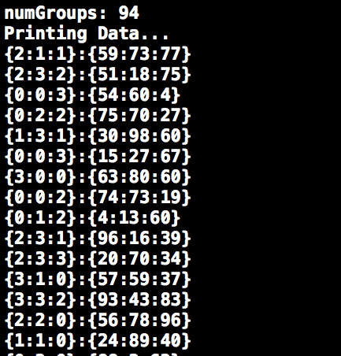
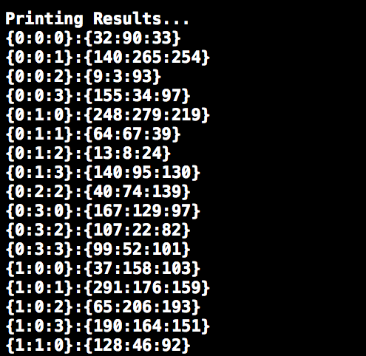
Early Verification Process
Input Data
Output Data

Slide 20
Performance

Slide 21
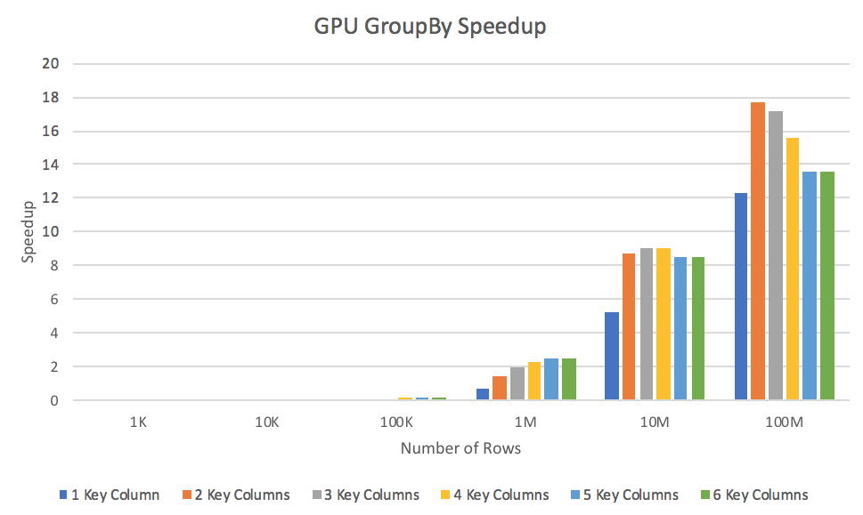

Slide 22
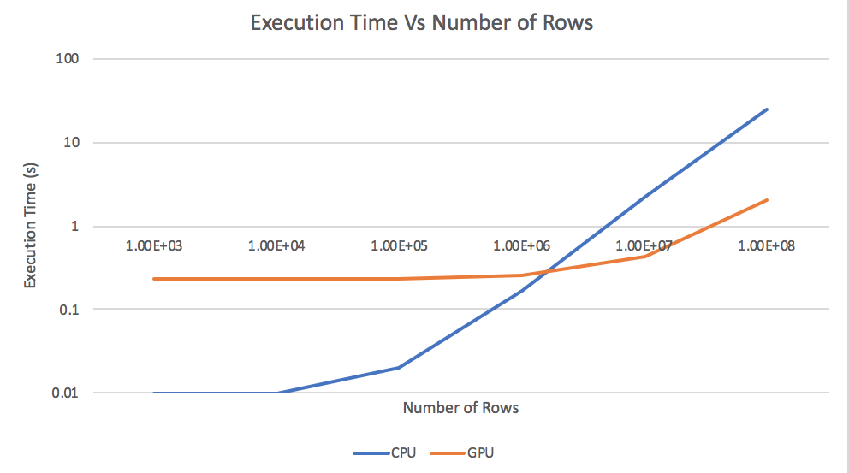

Slide 23
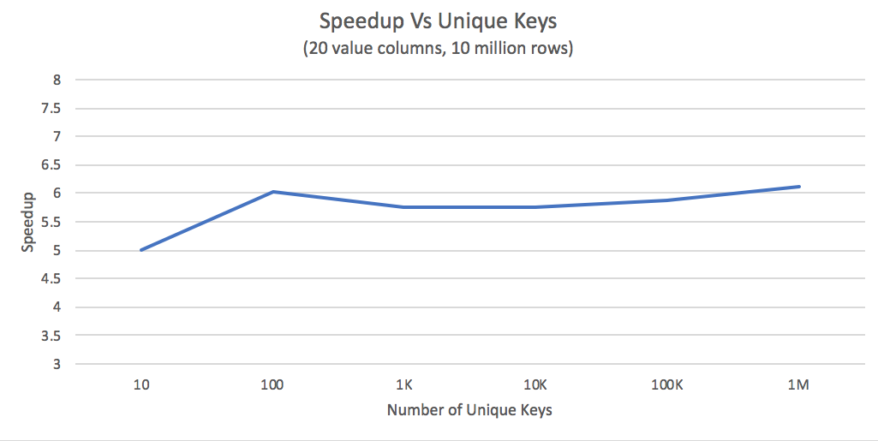

Slide 24
Profiling Result (10M elements)
Total gpu execution time 1.4s
73.69% time of kernel calls are cudaMemcpyHtoD used by thrust (211.16ms)
98.54% time of api calls are cudaMalloc cudaMemcpyAsync and cudaFree (~1s total)
IO operations are the largest bottleneck in the implementation
Using pinned memory could help

Slide 25
Observed results
The execution time of our group-by implementation on random simulated matrix
--GPU version performs well within certain range of matrix size
The performance varied along with different number of key columns
The running time can have large jumps for certain combination of keys
The execution time increases huge when groups are large

Slide 26
Conclusions

Slide 27
Take Home Message
When matrix size is small---- C++ STL (Standard Template Library) is faster than the GPU implementation
When matrix size is huge (Over one million rows)-- GPU code is up to 20x faster
Thrust is a great library for accelerating GPU development time (Includes functions like scan and reduce)

